Slide 1
GANimals
CS 455 Final Project
Daniel Khalil, Luke Crump, Vivian Dang

Slide 2
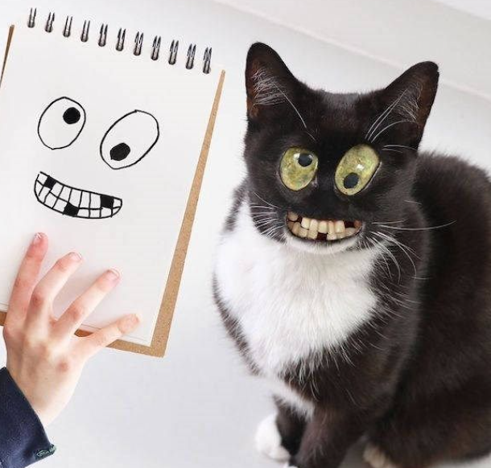
Overview of Challenge
There was a need for mass creation of monstrous animal faces.
Doing this traditionally, either by hand-drawing or photoshop, proved to be too time-consuming.
Thus, GANimals was born.

Slide 3
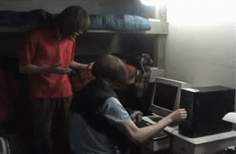
Limitations
Hardware
Most of our computers were not strong enough to handle generating the images.
Dataset
Kaggle dataset is limited to mammal faces only, but “GANmals” wasn’t as catchy.

Slide 4
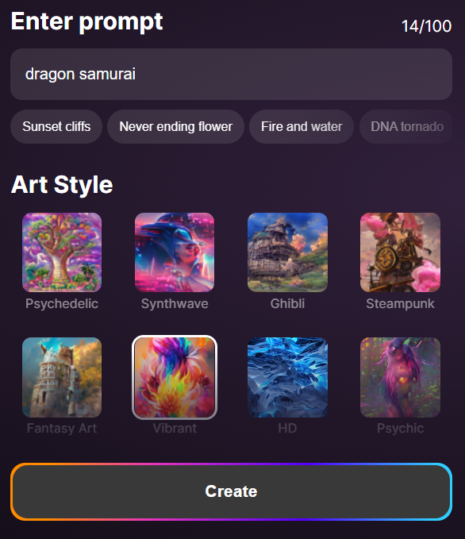
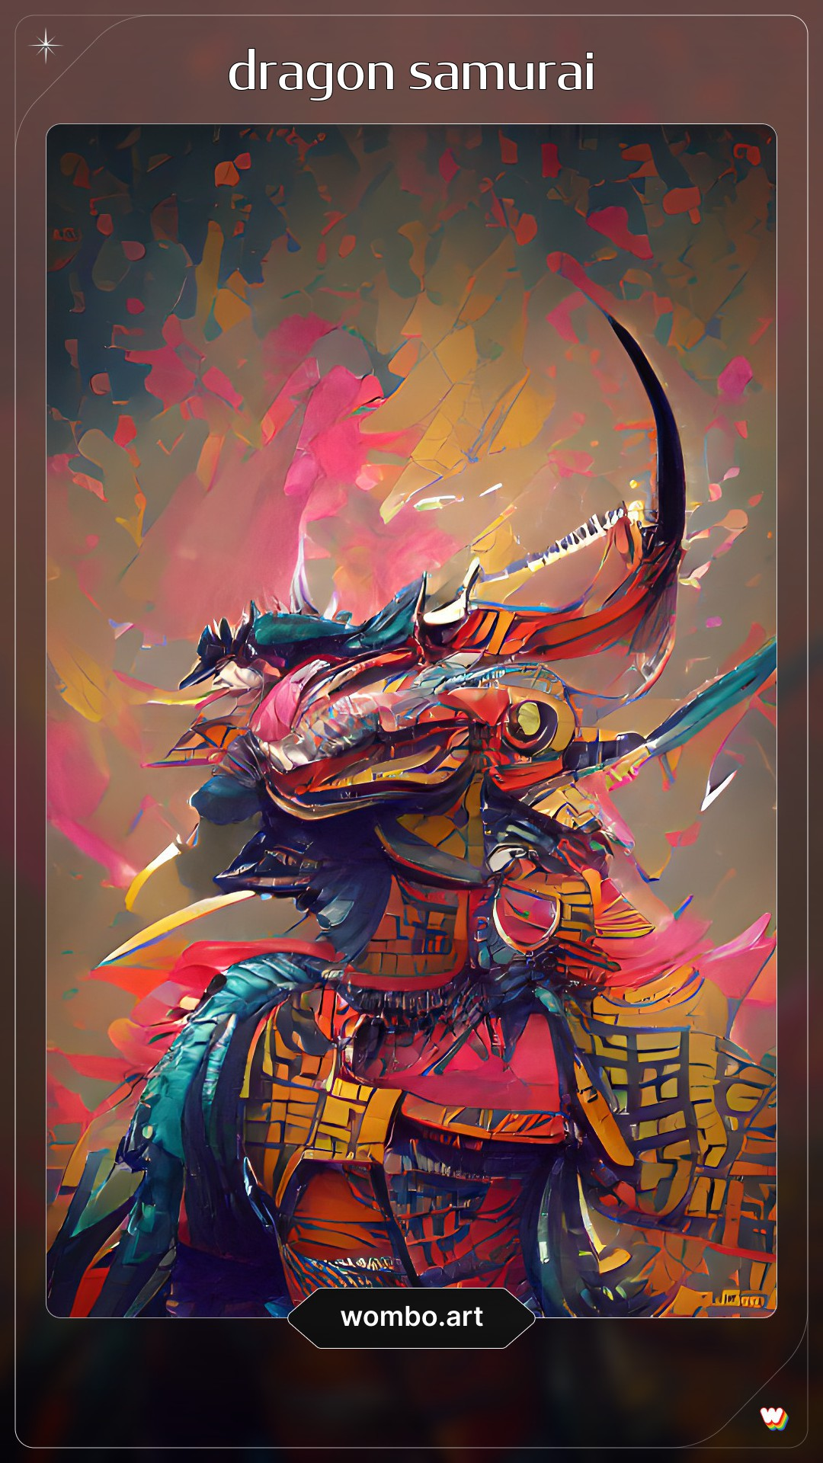
Approach
The images were generated using GANs, otherwise known as Generative Adversarial Networks.
There have been many other applications in art* that also utilize GANs.
*Ours is not this good.

Slide 5
Algorithm

Slide 6
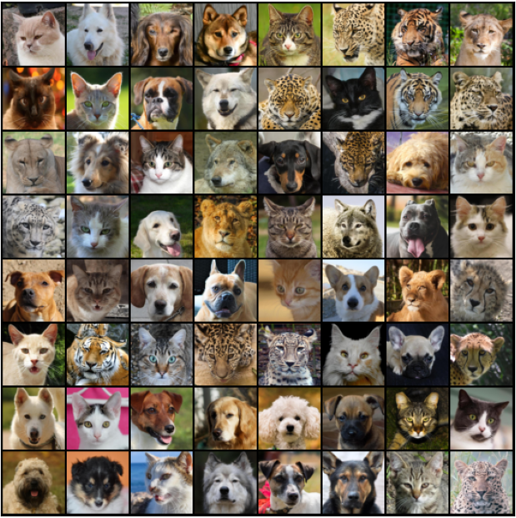
Key Resources
Kaggle Animal Faces Dataset which includes 16,130 high-quality images at 512×512 resolution.
The images were split into three categories:
Cats
Dogs
Wildlife

Slide 7
Solution

Slide 8
DEMONstration

Slide 9
Thank You!
Any Questions?

